Slide 1
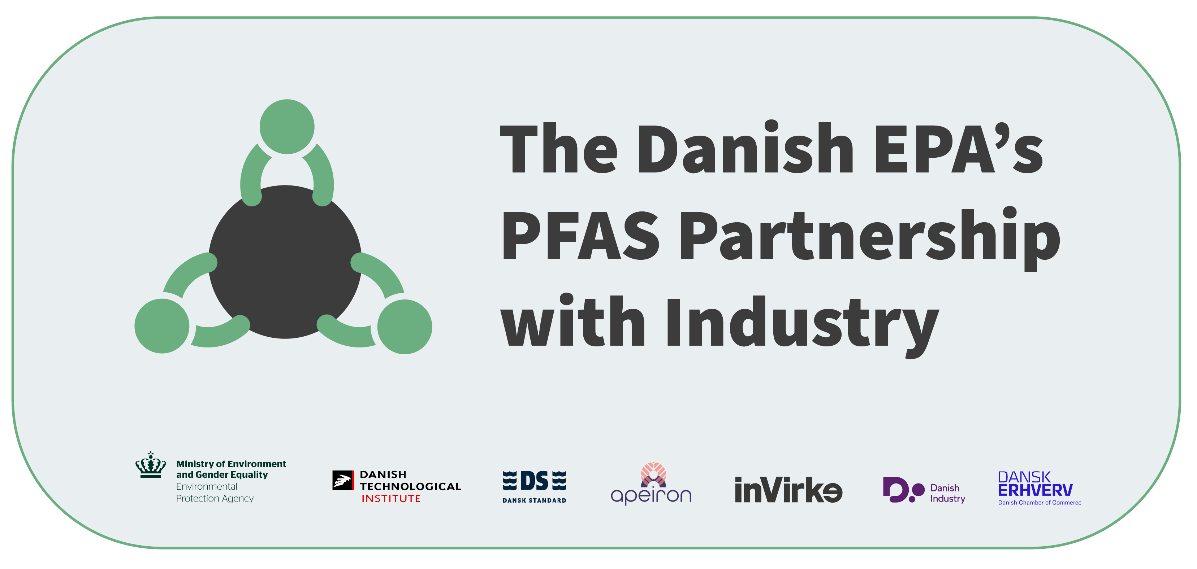

PFAS on
the agenda
Template for presentation to be adapted to the individual company
and target audience
pfas-partner.dk

Slide 2
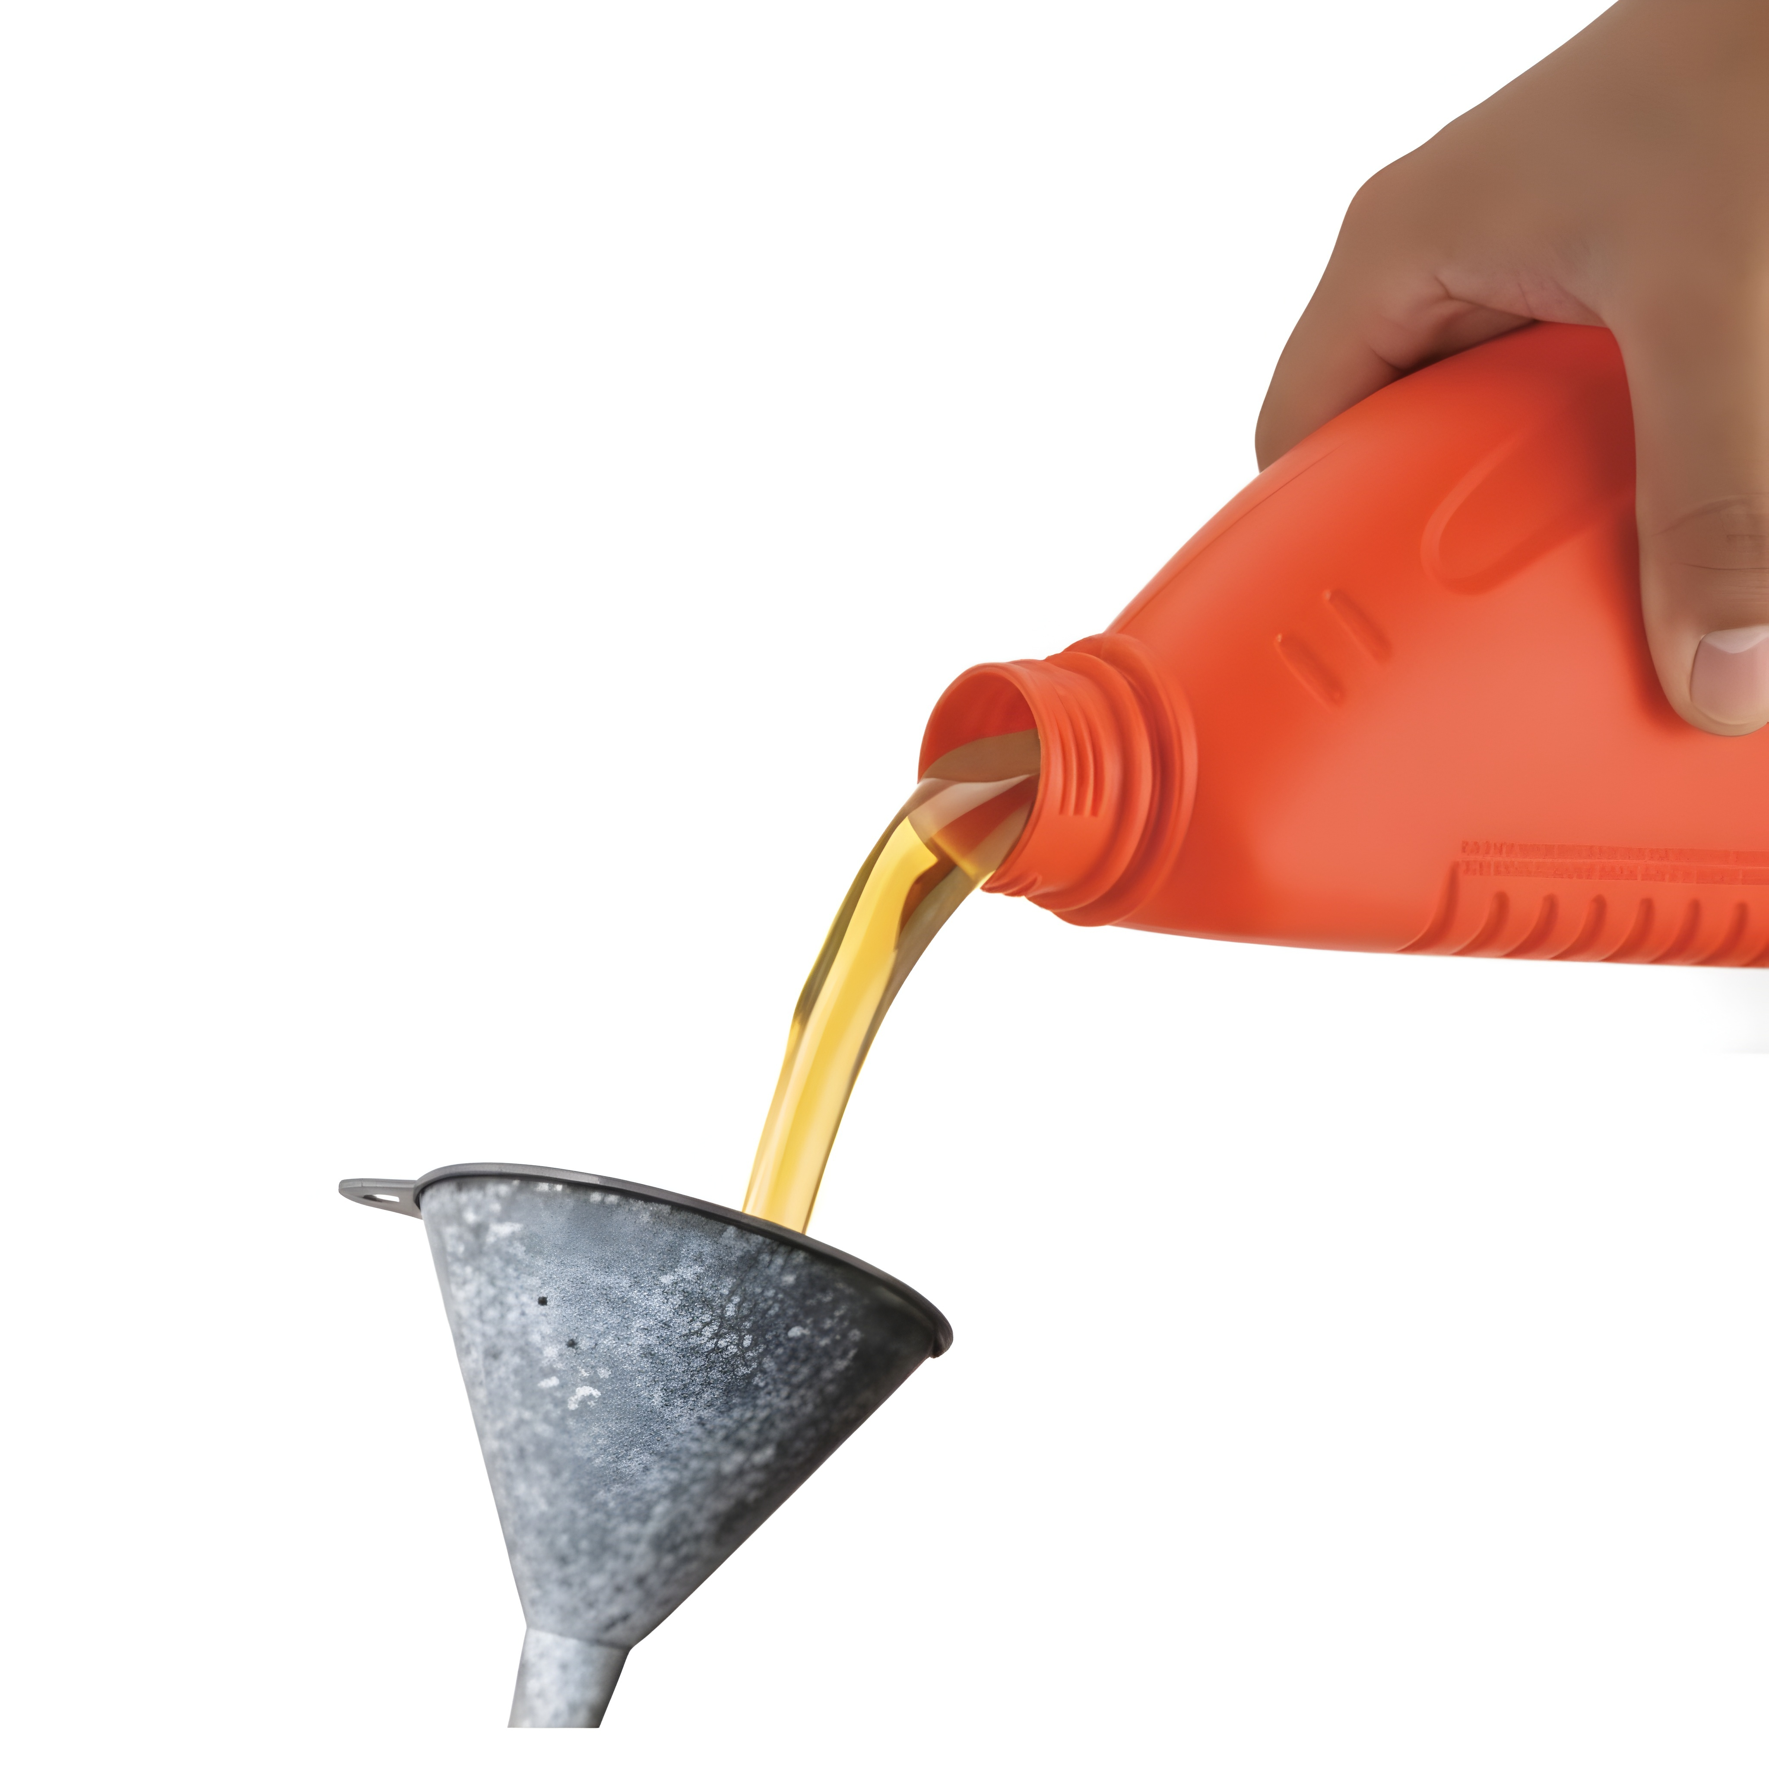


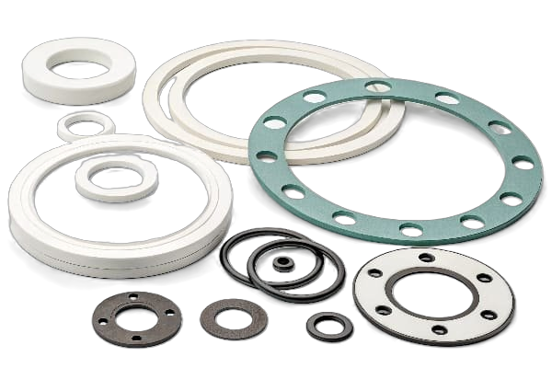

What is PFAS?
A collective term for a group of more than 10,000 chemical substances that contain carbon-fluorine bonds
PFAS have a wide range of properties, for example UV resistance, heat tolerance, chemical resistance, water and dirt repellency, electrical insulation, flame retardancy, low friction, and non-stick
Teflon and Gore-Tex are examples of well-known brands that contain PFAS

Slide 3

From wonder substance to forever chemical
PFAS have been used in industry since the 1950s – in everything from spacecraft to everyday products
Today, PFAS are found in millions of products across all industries: electronics, textiles, packaging, medical equipment, building materials, cosmetics
PFAS are highly persistent and can therefore accumulate in such large quantities that they can be harmful to the environment and humans – that is why PFAS are also called forever chemicals
PFAS can, among other things, affect the immune system and fertility – some PFAS are suspected of being endocrine disruptors and carcinogens

Slide 4
Why should we talk about PFAS?
New EU legislation restricting the use of the entire group of PFAS is expected to be adopted in 2027 - this means that virtually all industries and their supply chains will be affected
1
An 18-month transition period and exemption for continued use of PFAS in certain applications is expected while alternatives are developed
2
BUT: More and more consumers and companies are starting to avoid products with PFAS, and increasing regulation amplifies the negative perception of companies that continue to use PFAS
3
Therefore, the production of PFAS is also increasingly being phased out, and this could have major consequences for delivery capacity and price
4
The uncertain landscape also means that insurance companies have started to multiply insurance premiums for product groups containing PFAS
5

Slide 5



What does it mean for us?
We don't just have to address PFAS because of the upcoming legislation – we have to do it to:
Strengthen our reputation, future-proof our business – and gain potentially significant competitive advantages
Mitigate the risk of legal violations, fines and lawsuits in a market characterized by increasing regulation and bans on PFAS
And because we take responsibility for both employee safety, health and the environment

Slide 6



What should we do?
We need to understand:
Where PFAS can occur in our products, production and supply chains
Which risks and costs are associated with phasing out PFAS
How we ensure reliable information about PFAS content from our suppliers
What viable alternatives to PFAS already exist in our industry
What expertise is required to phase out and substitute PFAS
It's a lot of work, but we can also use it to:
Increase transparency and simplify our supply chains
Rethink and improve our products

Slide 7

What is the next step?
Establish an internal working group to drive the efforts
Ensure training of key employees
Contact key suppliers with questions about PFAS
Conduct an impact assessment to gain better insight into risks and costs
Collaborate and share knowledge and experiences with other companies – e.g. by participating actively in the Danish EPA’s PFAS Partnership for Businesses

